Slide 1
String and Exception Handling
Punit Sharma

Slide 2
Content
String Handling
-Use Of String, Introduction, String Pool, Interfaces
Exception Handling
-Result of Case Study on Basic Human Error Rate, Introduction, Handling
Using try-catch

Slide 3
String Handling
Use of Strings
You know that login screen, where you type in your username and password? Strings.
Those product descriptions on shopping web sites? Strings.
Most web output on any page of a Java web application will be made up of lots of little Strings of data. It might even all be a giant String as it is assembled.
Whenever you pull any text data out of a database - you guessed it, Strings.
They are everywhere, used for everything. Just think up some text data, and say “that goes in a String”

Slide 4
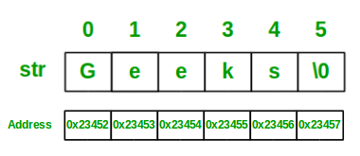
continued
Strings in Java
Strings are defined as an array of characters. The difference between a character array and a string is the string is terminated with a special character ‘\0’.
Below is the basic syntax for declaring a string in Java programming language.
Syntax:
<String_Type> <string_variable> = “<sequence_of_string>”;
Example:
String str = "Geeks";
String is a sequence of characters. In java, objects of String are immutable which means a constant and cannot be changed once created.

Slide 5
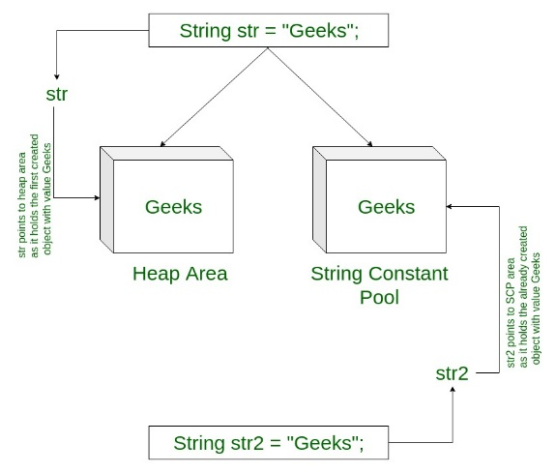
continued
Memory allotment of String
Whenever a String Object is created, two objects will be created- one in the Heap Area and one in the String constant pool and the String object reference always points to heap area object.
For example:
String str = "Geeks";

Slide 6
continued
Interfaces and Classes in Strings in Java
CharBuffer: This class implements the CharSequence interface. This class is used to allow character buffers to be used in place of CharSequences. An example of such usage is the regular-expression package java.util.regex.
String: String is a sequence of characters. In java, objects of String are immutable which means a constant and cannot be changed once created.
Creating a String
There are two ways to create string in Java:
String literalString s = “GeeksforGeeks”;
Using new keywordString s = new String (“GeeksforGeeks”);
StringBuffer: StringBuffer is a peer class of String that provides much of the functionality of strings. String represents fixed-length, immutable character sequences while StringBuffer represents growable and writable character sequences.
Syntax:
StringBuffer s = new StringBuffer("GeeksforGeeks");
StringBuilder: The StringBuilder in Java represents a mutable sequence of characters. Since the String Class in Java creates and immutable sequence of characters, the StringBuilder class provides an alternate to String Class, as it creates a mutable sequence of characters.
Syntax:
StringBuilder str = new StringBuilder(); str.append("GFG");
StringTokenizer: StringTokenizer class in Java is used to break a string into tokens.

Slide 7
Exception Handling
Study | Detail | Error Rate
Baddeley & Longman [1973] | Entering mail codes. Errors after correction. Per mail code. | 0.5%
Chedru & Geschwind [1972] | Grammatical errors per word | 1.1%
Dremen and Berry [1995] | Percentage error in security analysts' earnings forecasts for reporting earnings | 30%
Grudin [1983] | Error rate per keystroke for six expert typists. Told not to correct errors, although some did. Per keystroke. | 1%
Hotopf [1980] | S sample (speech errors). Per word | 0.2%
Hotopf [1980] | W sample (written exam). Per word | 0.9%
Hotopf [1980] | 10 undergraduates write for 30 minutes, grammatical and spelling errors per word | 1.6%
Copyright 1997-2008 Panko

Slide 8
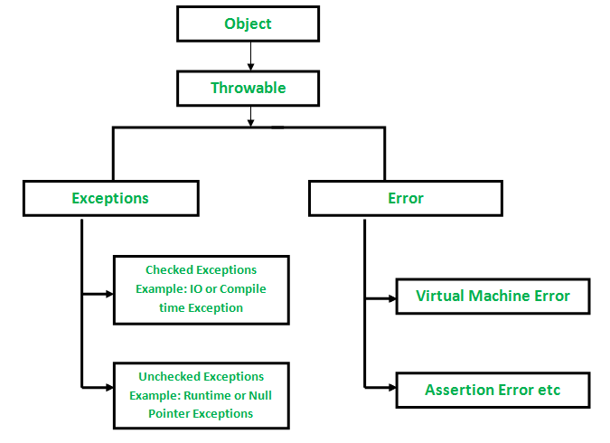
What is an Exception?
An exception is an unwanted or unexpected event, which occurs during the execution of a program i.e at run time, that disrupts the normal flow of the program’s instructions.
Error vs Exception
Error: An Error indicates serious problem that a reasonable application should not try to catch. Exception: Exception indicates conditions that a reasonable application might try to catch.
Exception Hierarchy
All exception and errors types are sub classes of class Throwable, which is base class of hierarchy.One branch is headed by Exception. This class is used for exceptional conditions that user programs should catch. NullPointerException is an example of such an exception.Another branch,Error are used by the Java run-time system(JVM) to indicate errors having to do with the run-time environment itself(JRE). StackOverflowError is an example of such an error.

Slide 9
continue
Handling Exceptions Using try and catch
The try structure has three parts:
The try block : Code in which exceptions are thrown
One or more catch blocks : Respond to different Exceptions
An optional finally block : Contains code that will be executed regardless of exception occurring or not
The catch Block:
If exception occurs in try block, program flow jumps to the catch blocks.
Any catch block matching the caught exception is executed.

Slide 10
Catching Exception Using try and catch
The general form of exception handling block:
try {
//code to be monitored.
}
catch (Exception1 e1 ) {
//exception handler for Type Exception1
}
catch (Exception2 e2 ) {
//exception handler for Type Exception2
}
finally {
// code that must be executed.
}

